Slide 1



Slide 2
Meet RenSecureHealth
Wide-ranging coverage in one plan that pays cash benefits for 13,000+ injuries and illnesses.
Benefits based solely on the medical condition
No accident or hospitalization requirements
Lump-sum cash benefits
Benefits are payable upon diagnosis and during the active treatment phase of illnesses
No limitations or exclusions for pre-existing conditions
No medical questions
No coordination with other benefits
MODERATE
CONDITIONS
6,000+ covered conditions
Injuries or illnesses that likely require a short trip to the ER or urgent care facility.
SEVERE
CONDITIONS
5,600+ covered conditions
Serious conditions that require more intensive medical treatment and attention.
CATASTROPHIC
CONDITIONS
1,500+ covered conditions
Dangerous or life-threatening conditions that require immediate medical intervention.
2

Slide 3
RenSecureHealth conditions list at a glance
MODERATE CONDITIONS (6000+ covered)
SEVERE CONDITIONS (5800+ covered)
CATASTROPHIC CONDITIONS (1500+ covered)
Anaphylactic reaction
Basal cell carcinoma of skin
Benign breast tumor
Carcinoma in situ of skin
Concussion
Cracked tooth
Dehydration
Diaphragmatic hernia
Foreign body in eye, ear or nose
Fractures/dislocations
Kidney stones
Lacerations
Meningitis
Migraines (intractable)
Myocarditis
Occlusion of carotid artery
Open bites
Pneumonia
Preterm newborn (34 or 35 weeks)
Second-degree burns
Sprain of ACL/MCL
Torn retina (no detachment)
Transient cerebral ischemic attack (TIA)
Acute pancreatitis
Acute respiratory failure
Anaphylactic shock
Appendicitis
Benign neoplasms
Carcinoma in situ (not skin)
Chronic adenoiditis/tonsillitis
Congestive heart failure
Deep-vein thrombosis
Detached retina
Diverticulitis
Gallstones
Inguinal hernia
Pleural effusion
Malignant melanoma
Preterm newborn (32 or 33 weeks)
Pulmonary embolism
Third-degree burns (<50% of body)
Torn achilles tendon
Torn ACL/MCL/meniscus
Torn rotator cuff
Unstable angina
Ventral hernia
Abdominal Aortic Aneurysm
ALS (Lou Gehrig's disease)
Alzheimer's
Cancer (malignant neoplasms)
Cardiac arrest
Cerebral hemorrhage
End-stage renal failure
Heart attack
Hodgkin lymphoma
Human immunodeficiency virus (HIV)
Leukemia
Loss of limb
Loss of sight in both eyes
Low birth weight (<1750 grams)
Multiple sclerosis
Paralysis
Parkinson's disease
Preterm newborn (31 weeks or less)
Sepsis
Spina bifida
Stroke
Third-degree burns (>50% of body)
Ventricular fibrillation

Slide 4
Benefit Separation Periods
Number of RenSecureHealth Payouts
Benefits are payable only once per insured within the separation periods noted below:
Limits on the number of payouts per each benefit category are noted below:
MODERATE CONDITIONS
14 Days
MODERATE CONDITIONS
No Limit
SEVERE CONDITIONS
30 Days
SEVERE CONDITIONS
No Limit
CATASTROPHIC
CONDITIONS
90 Days
CATASTROPHIC
CONDITIONS
3 times per lifetime per condition grouping*
Separation periods only apply within each benefit category. They do not apply between benefit categories. A Moderate benefit can be paid at the same time as a Severe or a Catastrophic benefit.
There are 52 condition groupings. Examples include, but are not limited to: cancer, stroke, heart attack, burns, and degenerative nervous diseases, etc.
*Catastrophic payout limit is on a per covered member basis.

Slide 5
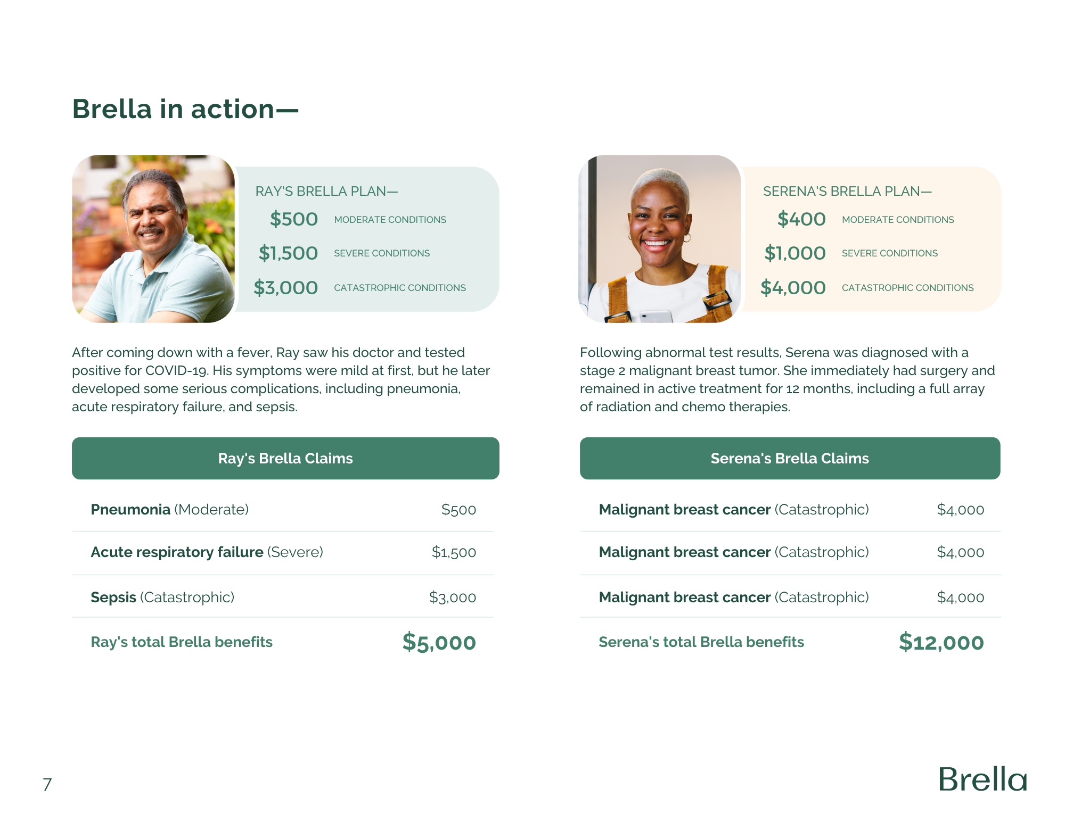
Benefit Separation Periods—
Number of RenSecureHealth’s Payouts—
Concussion (Moderate)
$200
Malignant breast cancer (Diagnosis)
$1,000
Fracture of hip (Severe)
$500
Malignant breast cancer (Surgery)
$1,000
Sepsis (Catastrophic)
$1,000
Malignant breast cancer (Chemotherapy)
$1,000
*These examples are illustrative. Benefit values listed do not guarantee an amount to be paid for listed conditions.
RAY’S RENSECUREHEALTH PLAN—
SERENA’S RENSECUREHEALTH PLAN—
$200
$200
Moderate Conditions
Moderate Conditions
$500
$500
Severe Conditions
Severe Conditions
$1,000
$1,000
Catastrophic Conditions
Catastrophic Conditions
Ray fell off a ladder at home, and suffered both a concussion and a fractured hip. While in the hospital receiving treatment, he also developed sepsis.
Serena was diagnosed with a stage 2 breast tumor, and underwent surgery and chemotherapy, triggering three catastrophic benefits over nine months. Serena is still eligible for other benefits even after hitting her catastrophic max for this condition grouping.
Ray’s RenSecureHealth Claims
Serena’s Catastrophic RenSecureHealth Claims
Ray’s total RenSecureHealth benefits
$1,700
Serena’s total RenSecureHealth benefits
$3,000

Slide 6

Simpler insurance means an easy claims experience.
Claims by mobile app or web portal
Claims can be submitted upon diagnosis
Paperless submission quickly—only 2 questions
Use photos of readily available claim evidence
No need to wait weeks for an EOB or bill
Payment to bank account, PayPal, or Venmo
Supported by dedicated Member Care Representative
Benefit payment is usually within 72 hours of a claim.
Notes:
Update phone image to feature RenSecureHealth

